Slide 1

Bundelkhand Institute Of Engineering And Technology, Jhansi ( U.P. )
(An autonomous institute affiliated to Dr. Abdul Kalam Technology University (A.K.T.U.) )
Major Project Presentation
On
Coal Mining Safety Robot
Head Of Department :
Dr. Deepak Nagaria
Under the guidance of :
Er. Akansha Kaushal
Submitted By :
Abhishek Parmar ( 1904320002)
Aniruddh Parashar ( 1904320009)
Ankit Srivastava ( 1904320011 )

Slide 2
Content
Introduction
Block Diagram
Components Used In Working Model
Work Progress
References

Slide 3
Introduction:
This project is used for the inspection of Coal Mines.
In this robot, we are using different sensors : Temperature Sensor, Humidity Sensor, Gas Sensor.
These sensors will help in analyzing the conditions inside the coal mine .
The data sent by these sensors can be seen on the operating device.

Slide 4
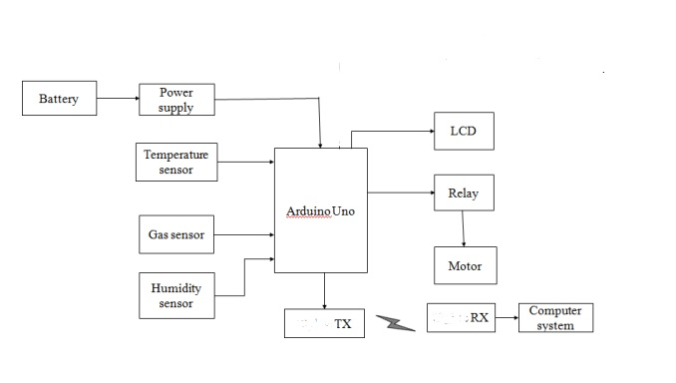
Block Diagram of Model :

Slide 5
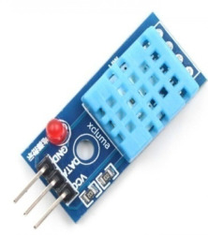
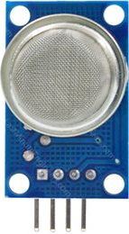
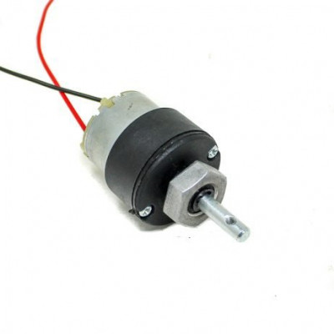
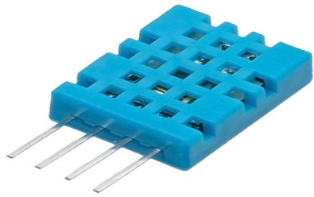
Components Used in Working Model:
Microcontroller
Battery
Temperature Sensor
Gas Sensor
Humidity Sensor
Motor
Wheels
Transmitter And Receiver

Slide 6
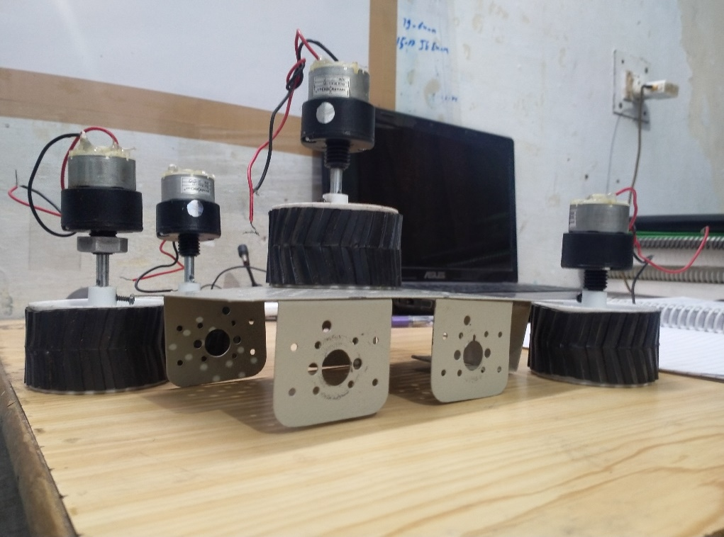
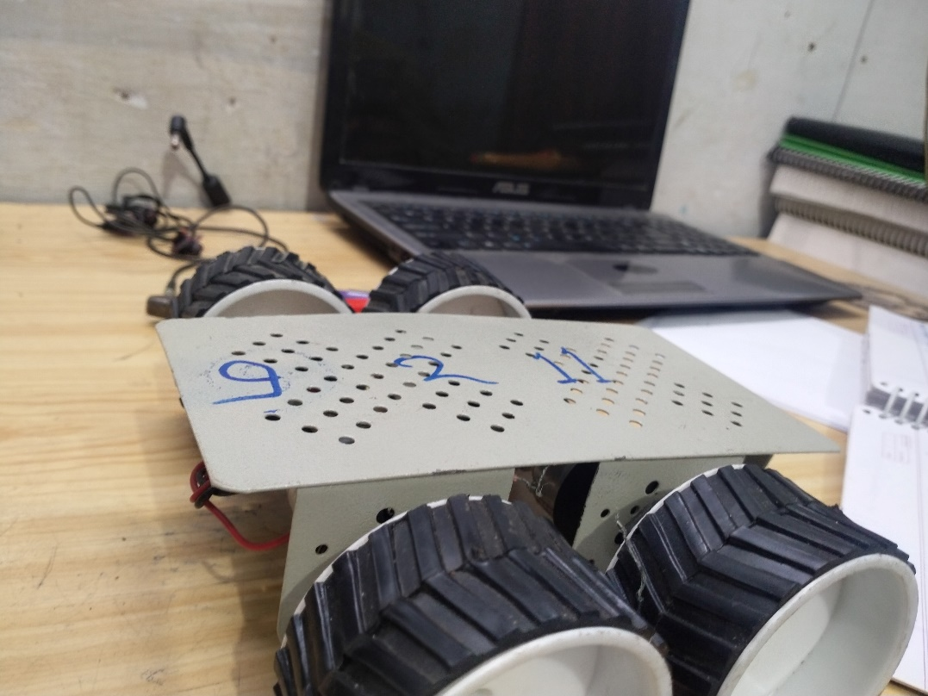
Work Progress
Mine Rover

Slide 7
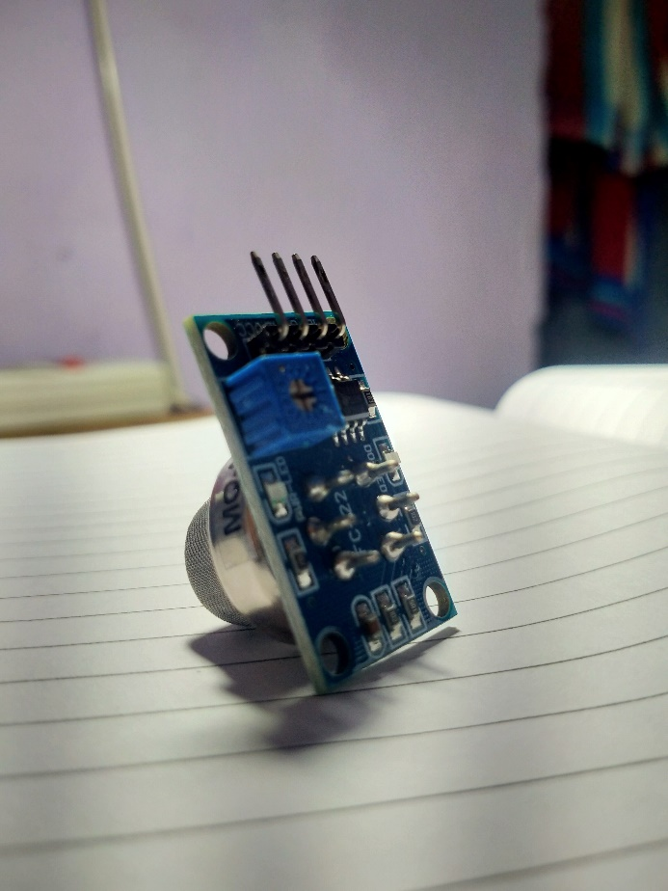
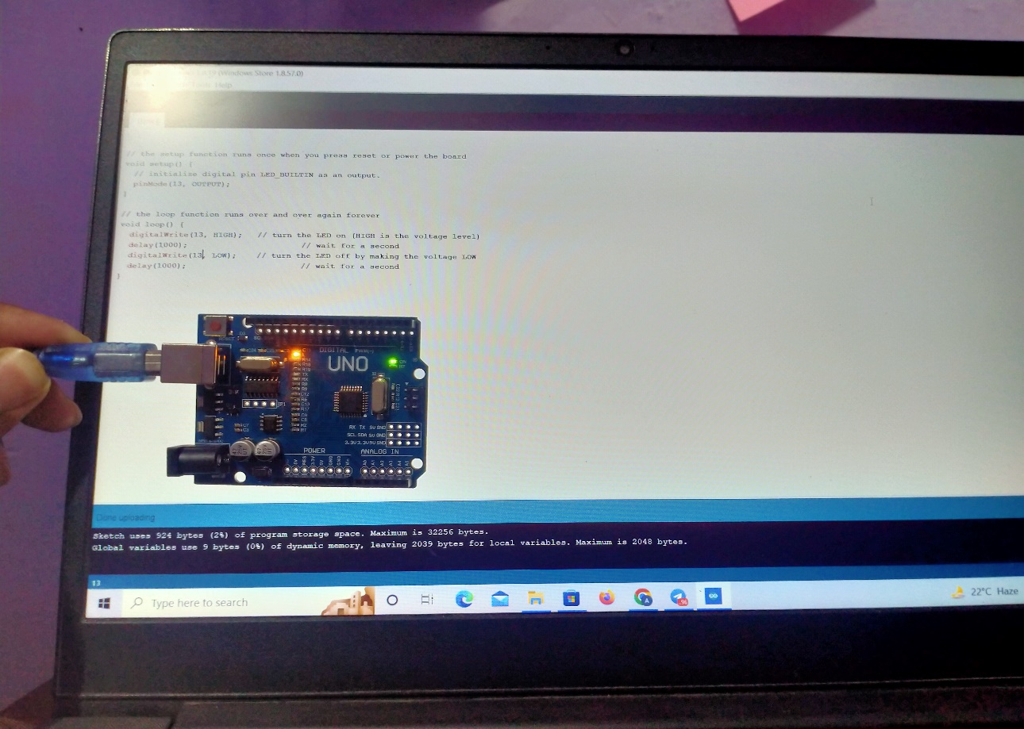
Testing

Slide 8
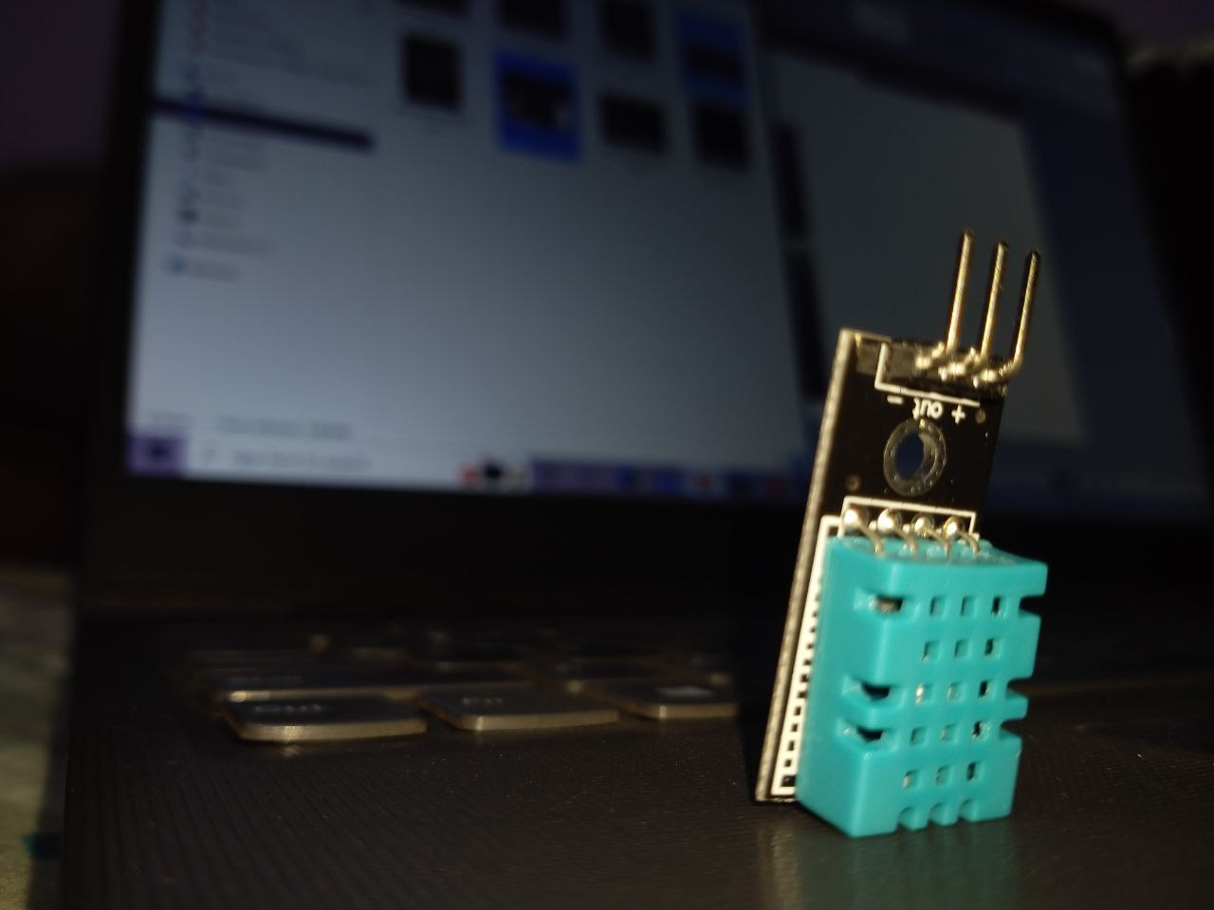
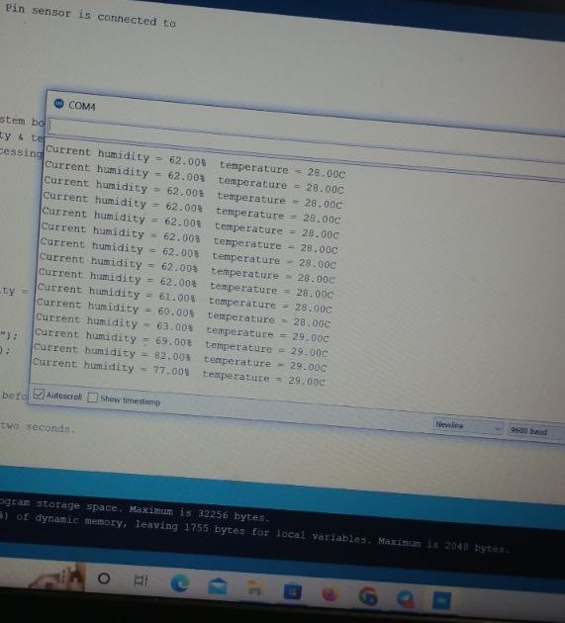

Slide 9
References
https://www.researchgate.net/publication/341131035_Mine_Safety_Robot/link/5fbdf64b92851c933f57c681/download
https://ieeexplore.ieee.org/abstract/document/9141234
https://www.jamris.org/index.php/JAMRIS/article/download/247/247
https://www.tandfonline.com/doi/abs/10.1080/02564602.2014.995142
https://coal.gov.in/sites/default/files/2019-11/chap11AnnualReport1718en.pdf
https://www.sciencedirect.com/topics/engineering/mine-explosions

Slide 10
Thank You

